Slide 1
Recurrent Neural Networks
COSCI 223 – Machine Learning 3 🧠
Sebastian C. Ibañez
sibanez@aim.edu
Asian Institute of Management

Slide 2
Outline
Sequential Data
Recurrent Neural Networks
Application: Language Models

Slide 3
Sequential Data

Slide 4
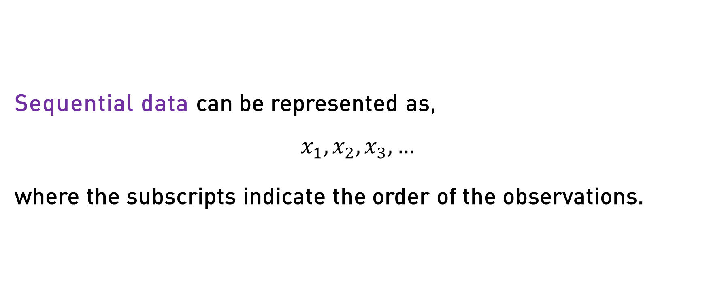
Sequential Data
Sequential data can be represented as,
$$x_{1},x_{2},x_{3},…$$
where the subscripts indicate the order of the observations.
Notes:
In this case, x_i could be:
a scalar value (e.g., univariate time series)
a vector of real numbers (e.g., word embedding)
a matrix/tensor (e.g., sequences of images)

Slide 5
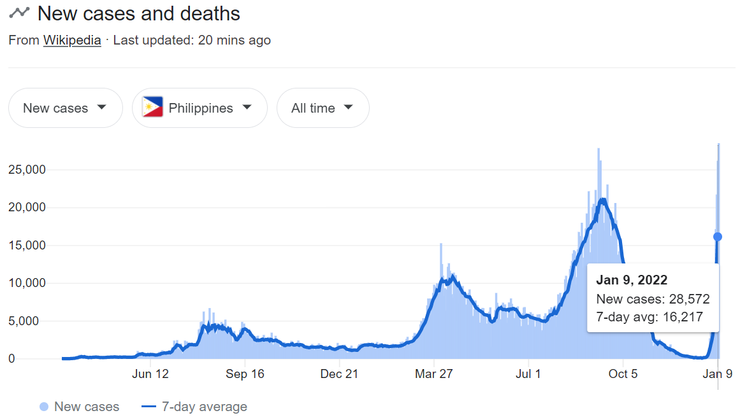
Example – Time Series

Slide 6
Example – Text
 | the | quick | brown | fox | jumps | over | the | lazy | dog

Slide 7
Deep Learning Tasks for Sequential Data
Task | Input | Output | Models
Speech Recognition | Audio | Text | wav2vec, Whisper
Music Generation | Text | Audio | Jukebox, MusicLM
Sentiment Analysis | Text | Classification | BERT, RoBERTa
Machine Translation | Text | Text | BERT, GPT, T5
Text Generation | Text | Text | GPT, LLaMA
Video Activity Recognition | Video | Classification | VideoMAE, TimeSformer
Time Series Forecasting | Historical Values | Future Values | N-BEATS, DeepAR, TFT

Slide 8
Example – Audio

Slide 9
Example – Video

Slide 10
Recurrent Neural Networks

Slide 11
Why not use a MLP or CNN?
Sparse Connectivity.
We can reduce the number of parameters in our model
Parameter Sharing.
Learned features are shared across different positions
Variable Length Data.
Inputs and outputs can be of differing lengths
Notes:
Translation/Positional invariance: ‘Yesterday I ate an apple’ and ‘I ate an apple yesterday’ mean the same thing.

Slide 12

Recurrent Neural Network
$$h_{t}=f(h_{t−1},x_{t})$$
$h_{t}$ – hidden state at time $t$
$x_{t}$ – input at time $t$
$f(⋅)$– linear function with activation

Slide 13
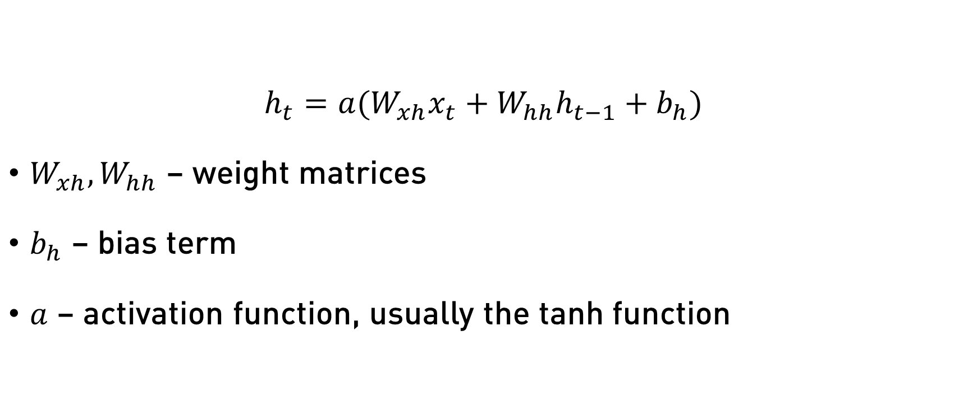
Recurrent Neural Network (Simple)
$$h_{t}=a(W_{xh}x_{t}+W_{hh}h_{t−1}+b_{h})$$
$W_{xh},W_{hh}$ – weight matrices
$b_{h}$ – bias term
$a$ – activation function, usually the tanh function
Notes:
Also known as Elman RNNs.

Slide 14
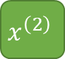

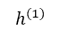


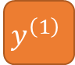
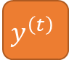
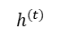
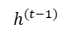
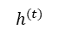
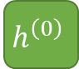
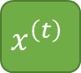
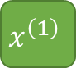
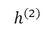

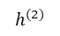
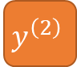
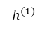
Recurrent Neural Network (Simple)
$$h_{t}=a(W_{xh}x_{t}+W_{hh}h_{t−1}+b_{h})$$
$$y_{t}=g(h_{t})$$
$$y^{\left(1\right)}$$
$$y^{\left(2\right)}$$
$$y^{\left(t\right)}$$
$$h^{(1)}$$
$$h^{(2)}$$
$$h^{(t)}$$
$$h^{\left(0\right)}$$
$$h^{(1)}$$
$$h^{(2)}$$
$$…$$
$$h^{(t−1)}$$
$$h^{(t)}$$
$$…$$
$$x^{\left(1\right)}$$
$$x^{\left(2\right)}$$
$$x^{\left(t\right)}$$
$g(⋅)$ here is an activation (e.g., sigmoid) or a neural network that transforms the hidden state into the desired target.

Slide 15
Backpropagation Through Time (BPTT)
For every output path, apply the backpropagation algorithm in reverse order on the unrolled RNN diagram.
$$y^{\left(1\right)}$$
$$y^{\left(2\right)}$$
$$y^{\left(t\right)}$$
$$h^{\left(0\right)}$$
$$…$$
$$…$$
$$x^{\left(1\right)}$$
$$x^{\left(2\right)}$$
$$x^{\left(t\right)}$$

Slide 16
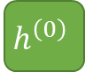


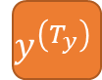



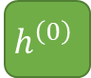
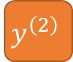


Types of RNNs Based on Application
One-to-one ($T_{x}=T_{y}=1$)
Ex. Traditional neural network
One-to-many ($T_{x}=1,T_{y}>1$)
Ex. Music generation
$$y^{\left(1\right)}$$
$$y^{\left(1\right)}$$
$$y^{\left(2\right)}$$
$$y^{\left(T_{y}\right)}$$
$$h^{\left(0\right)}$$
$$h^{\left(0\right)}$$
$$…$$
$$x^{\left(1\right)}$$
$$x^{\left(1\right)}$$

Slide 17
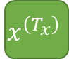
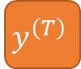





Types of RNNs Based on Application
Many-to-one ($T_{x}>1,T_{y}=1$)
Ex. Sentiment analysis
Many-to-many ($T_{x}=T_{y}$)
Ex. Name entity recognition
$$y^{\left(1\right)}$$
$$y^{\left(1\right)}$$
$$y^{\left(2\right)}$$
$$y^{\left(T\right)}$$
$$h^{\left(0\right)}$$
$$…$$
$$h^{\left(0\right)}$$
$$…$$
$$x^{\left(1\right)}$$
$$x^{\left(2\right)}$$
$$x^{\left(T_{x}\right)}$$
$$x^{\left(1\right)}$$
$$x^{\left(2\right)}$$
$$x^{\left(T\right)}$$

Slide 18


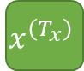


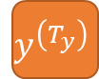




Types of RNNs Based on Application
Many-to-many* ($T_{x}≠T_{y}$)
Ex. Machine translation
$$y^{\left(1\right)}$$
$$y^{\left(2\right)}$$
$$y^{\left(T_{y}\right)}$$
$$h^{\left(0\right)}$$
$$…$$
$$…$$
$$x^{\left(1\right)}$$
$$x^{\left(2\right)}$$
$$x^{\left(T_{x}\right)}$$

Slide 19
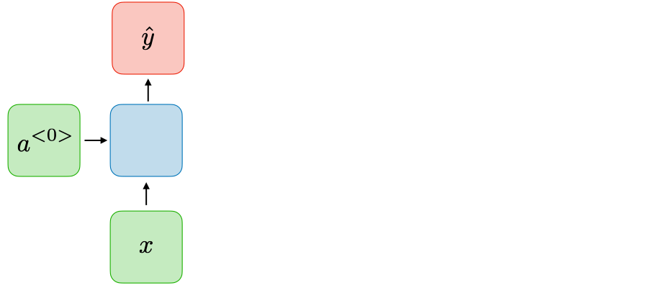
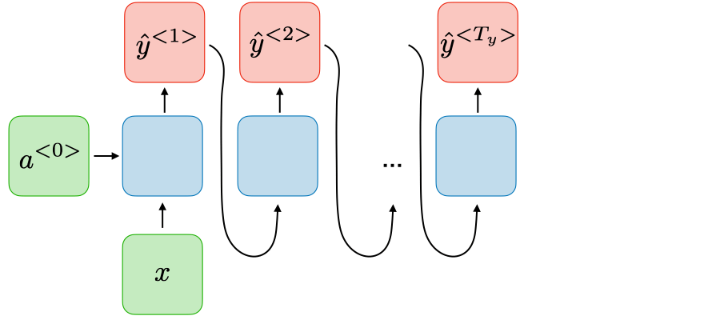
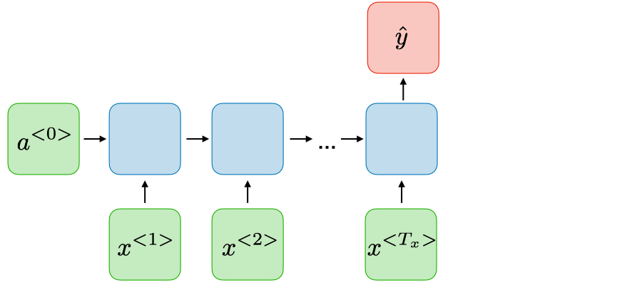
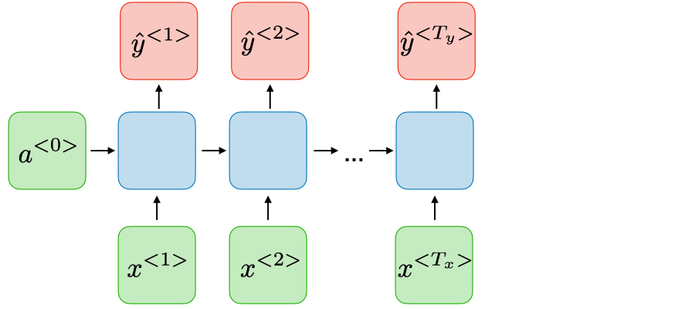
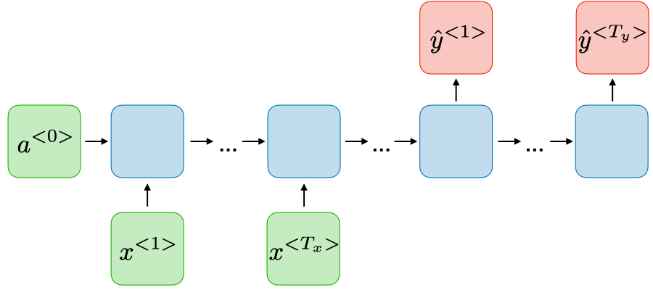
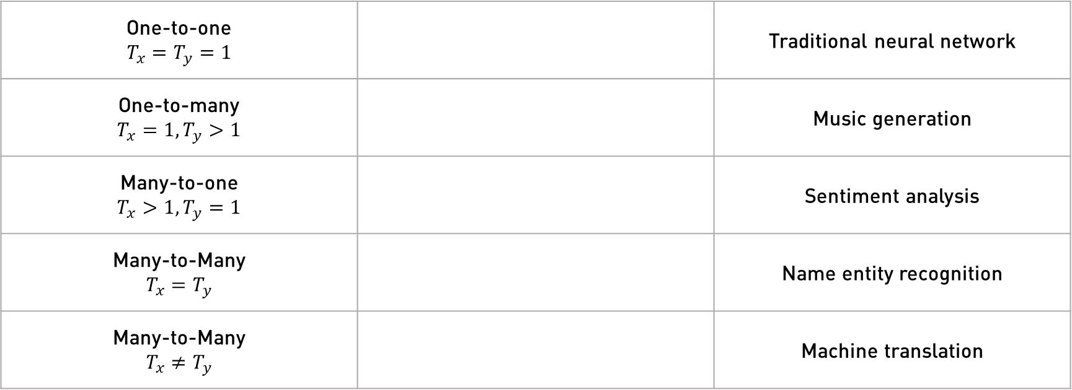
Types of RNNs Based on Application
Type of RNN | Illustration | Example
One-to-one $$T_{x}=T_{y}=1$$ |  | Traditional neural network
One-to-many $$T_{x}=1,T_{y}>1$$ |  | Music generation
Many-to-one $$T_{x}>1,T_{y}=1$$ |  | Sentiment analysis
Many-to-Many $$T_{x}=T_{y}$$ |  | Name entity recognition
Many-to-Many $$T_{x}≠T_{y}$$ |  | Machine translation

Slide 20
Application: Language Models

Slide 21
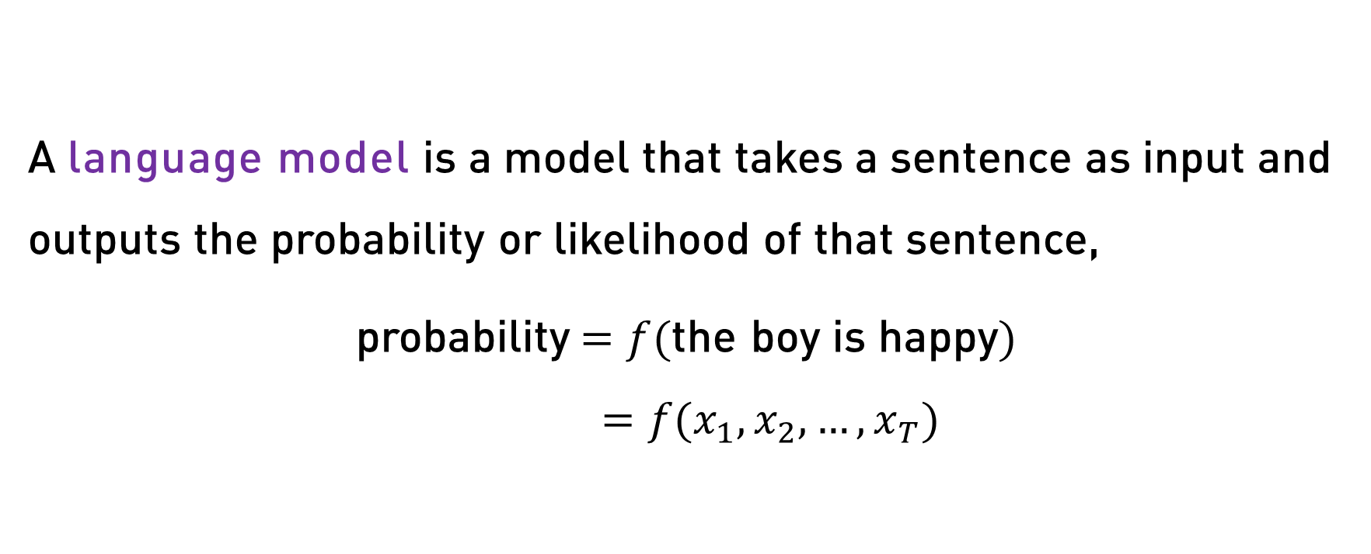
Language Model
A language model is a model that takes a sentence as input and outputs the probability or likelihood of that sentence,
probability$=f($the boy is happy$)$ $=f(x_{1},x_{2},…,x_{T})$

Slide 22
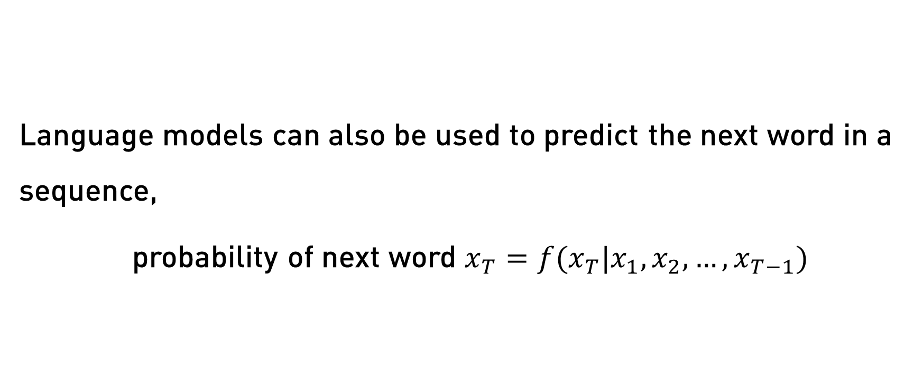
Language Model
Language models can also be used to predict the next word in a sequence,
probability of next word $x_{T}=f(x_{T}|x_{1},x_{2},…,x_{T−1})$

Slide 23
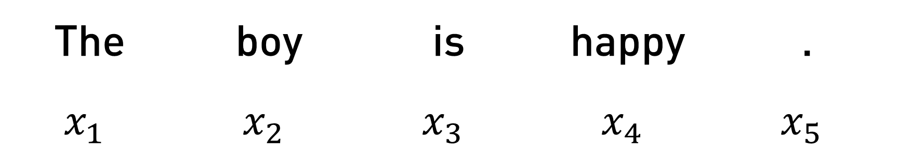
Language Modeling with an RNN
To train a language model we need to,
Collect a large corpus of text
Tokenize sentences in the corpus
Convert tokens to numbers
The | boy | is | happy | .
$$x_{1}$$ | $$x_{2}$$ | $$x_{3}$$ | $$x_{4}$$ | $$x_{5}$$

Slide 24

Language Modeling with an RNN
Logits
Logits
Logits
Dense Layer
Dense Layer
Dense Layer
Hidden States
$$…$$
Word Embedding
Word Embedding
Word Embedding
Embedding Layer
Embedding Layer
Embedding Layer
Word
Word
Word
Recall: “Logits” refer to the outputs right before they are passed to a softmax function, after which they become probabilities.

